Slide 1






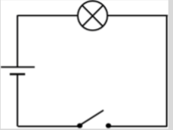


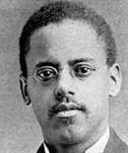
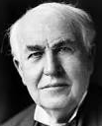
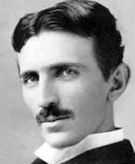
Electricity|Class 4
Vocabulary
physics | The study of forces including electricity and the way it affects objects.
circuit | A complete route which an electric current can flow around.
symbol | A visual picture that stands for something else.
current | A flow of electricity through an object such as a wire.
amps (A) | How electric current is measured.
voltage | The force that makes the electric current move through the wires. The greater the voltage, the more current will flow.
volts (V) | How the voltage is measured.
resistance | The difficulty that the electric current has when flowing around a circuit.
electrons | Very small particles that travel around an electrical circuit.
battery | A small device that provides power for electrical items (a collection of cells).
cell | A device used to generate electricity. A cell is a single unit.
Electricity Circuit Symbols
 | Lamp (indicator)
 | Lamp (lighting)
 | Cell
 | Battery
 | Wire
 | Motor
 | Buzzer
 | Open switch (off)
 | Closed switch (on)
A scientific diagram of an open circuit:
The lightbulb in this circuit will not light up until the switch is closed.
Timeline
1600 | An English scientist, William Gilbert, first coined the word ‘electricity’ from the Greek word for amber: elektron.
1729 | A ground-breaking discovery is made that electricity is not just generated from rubbing materials together but that some materials carry electrical charges called ‘conductors’ and some don’t (‘non-conductors’).
1752 | June 10, 1752, Benjamin Franklin flies a kite during a thunderstorm and collects ambient electrical charge in a Leyden jar, enabling him to demonstrate the connection between lightning and electricity.
1800 | The first electric light is invented by English scientist Humphry Davy. Alessandro Volta, an Italian, invents first battery.
1879 | Thomas Edison, an American, invented the modern lightbulb.
1883 | The first plug and socket are unveiled in England
Late 1880s – Early 1890s | The ‘War of the Currents’ takes place when Thomas Edison (Direct Current – DC) and Nikola Tesla (Alternating Current – AC) clash over which type of electricity supply is best. Tesla won.
1939-1945 | During World War II, electricity was a threat, as light allowed the enemy to identify places to bomb.
Important People
Alessandro Volta 1745-1827 | Benjamin Franklin 1706-1790 | Lewis Latimer 1848-1928 | Thomas Edison 1847-1931 | Nikola Tesla 1856-1943

