Slide 1
Everyday Learning

Slide 2
The Learning Triangle
Child
Home
School

Slide 3
Why are we here?
Children have 2 main educators in their life….parents & teachers.
The role of parents is crucial to a child’s success at school – from Reception to University.
Research shows that:
Where a parent is involved in helping their child learn, they achieve higher results in informal and formal tests throughout their schooling (age 3-19).
Children achieve more where schools and parents work together.
Parents have a bigger impact on their child’s learning when they know how the school would like them to support so that strategies are taught in the same way.
Parental behaviour and attitude towards learning has a bigger effect than school quality on pupil attainment at Key Stage 2.
The performance advantage among students whose parents read to them in early school years is evident regardless of the family’s socio-economic background.

Slide 4
Being a good learner relies upon different things…..
Having a positive attitude to learning.
Having the skills to be able to learn.
Developing knowledge and using this to learn new things.
Having confidence and self-esteem. Being happy.
Being given appropriate support from different networks. Accepting it and utilising it to best effect.

Slide 5
Positive attitudes
The attitude that we have about learning will rub off on our children.
Who has EVER said
‘Well, I didn’t do any good at school and I was rubbish at maths anyway’ ?

Slide 6
How can we foster positive attitudes to learning?
Let your child hear you talking positively about school (including your own school experiences).
Talk to your child about being a lifelong learner…..let them know when you’ve learnt something new.
Give them a daily challenge….to teach you something new once a week.
Encourage them to do well – have a great day today. Praise when targets have been met/certificates home.
Set academic targets – long term and short term.
Put learning into context. You need to know this because…..
Make sure book bags and homework have a special place.
Formal learning takes place in a special place – desk / workstation / dining table.
Do homework and formal learning when child is at their freshest…..not just before bed / as you’re running out the door in the morning. Message: It’s an add on and you just have to do it so you don’t get into trouble!

Slide 7
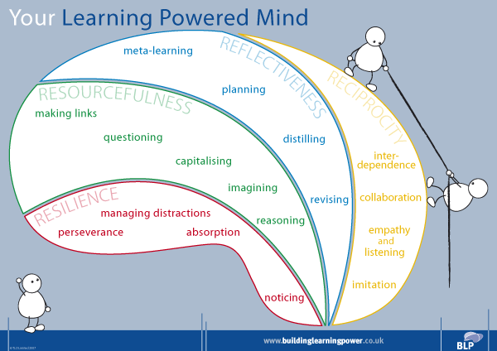
Building you child’s learning skills….
Being an independent learner.
Being able to organise tasks, things, time.
Making links between learning. (context, showing half the learning is already done)
Being able to ask questions. (curiosity, wonder, find things out together)
Perseverance. (puzzles, tricky eye spy, long tasks)
Managing distractions. (focus for certain time, concentration, choose whether to get rid of distractions etc)
Working alone and in collaboration. (use others’ skills)
Reasoning & evaluating. (How did they do? What could have gone better? Even better if…, give choices and consequences)
Discussion skills. (turn taking, give reasons for choices, persuade others)

Slide 8
How can we help them develop greater independence?
Children should take responsibility for their learning early on (homework, reading book, asking for help).
Know where resources are to help them (have a pencil case, special place to work, clock).
Get them to explain the task to you (they have to have listened carefully to the task in class and then share the instructions with you – by verbalising actions, children become more able to do the task).
Review the task together (How did you do? Did you need help with anything? If they need help….what do you already know that might help you with this?).

Slide 9
How can we help them develop greater organisational skills?
Organise tasks:
Talk me through it as you do it.
Have you got everything you need to be able to do your work?
Let them know what you have to do around the home and get them to help you.
Organise time:
When will you do this piece of work? Straight away or after your snack?
How long do you think it will take?
Don’t plough on for hours with work they find tricky….request 100% for a short time.
Organise things:
Bookbag (Who packs it? What needs to be in it? Where are they kept?)
List equipment needed for school each day and tick it off.
Get children to help pack away their clean clothes/dishes etc.
Agree a time for formal homework and stick by it.
Homework diary / reading record – keep in touch and sign it.

Slide 10
Getting your child to ask questions…
“…the best learners ask the best questions.”
Encourage them to ask you what new vocabulary/words mean.
Encourage them to ask ‘why?’ questions.
Ask them ‘Why do you think that happened/works?’
Play: ‘Ask me a why/what/when/where question about my day’.
Answer their ‘why’ questions as best as you can.
Do 1-to-1 show and tell.
When you answer questions, use correct vocabulary – this builds vocabulary and makes them feel very grown up.
When you don’t know the answer, find out together – ask someone else OR look it up.
Ask your child what they did today in school to model questioning. When they have forgotten (!!), give them prompters or have a record of all we’ve learnt this week. Challenge them to teach you something new each week/day.
Interview people for school projects / diaries etc and write up answers.

Slide 11
Helping your child build confidence & self-esteem.
As standard…
Praise them – celebrate every little step.
Find jobs for them that they can succeed at and point out how well they’ve done.
Encourage play dates with friends.
Encourage going to new places.
Show them how much they’re able to do without you helping them.
Reassure them you’re there when you need them.
See things through…always make sure promises are kept so that they trust you.
When things are tricky…
Remind them how far they’ve come and all they’ve learnt.
Give them a token from you to keep close to them and give them strength at tricky times.
You’re in my mind today…strategy for keeping you close and giving them confidence to try things.
Reward things the family have done well this week.
Have an ABCD award within the family (above and beyond the call of duty).

Slide 12
Developing knowledge
Talk about what they’ve learnt today.
Answer the ‘why’ questions for them.
Find out things they want to know about.
Give them skills to show them where/how they can find things out to develop independent acquisition of knowledge: internet, books, dictionary, thesaurus, encyclopaedia, library, ask people.
Encourage them to be independent so they don’t learn helplessness.
Help them learn for formal / informal tests: ultimately these are skills they’ll need for future qualifications.
Where retention of knowledge is tricky:
Decide what they NEED to know as a minimum.
Set targets and do everything as a team to meet them.
Overlearn facts they need to know.
Don’t overload them.
Little and often works better than ploughing on with tasks for hours.
Make learning FUN!
Here are some tips about how to do this…

Slide 13
Everyday activities to do…..where your child won’t realise they’re learning:
Limit time on electronic gadgets in favour of puzzles, social interaction games, pencil and paper games.
Go shopping and pay for things with coins rather than cards – maths and reading shopping list.
Go to the library.
Use the TV pages to work out what time their programme is on.
Do chores and give pocket money.
Treasure hunts with riddles as clues.
Cooking – measuring out, following instructions.
Making things – instructions, buying resources, physical skills.
Writing invitations, cards, thank you letters.
Sorting and sharing sweets between siblings.
Tidying up – sorting things into spaces/homes and giving responsibility.
Helping with keeping to speed limits in car.
Reading signs on road and helping with directions.
Reading menu at restaurant.
Nursery rhymes, riddles, dancing.

Slide 14
Games to help learning…
Kims game – memory development.
Eye spy – phonics.
Boggle / hangman / scrabble.
Patience (cards).
Treasure hunt for something starting with each letter of alphabet.
Be the first to spot…
Altering stories to involve them.
Writing letters / wish list to Santa.
Writing a diary.
Crosswords/word searches.

Slide 15
Every Day Reading in the Early Years

Slide 16
What are your memories of reading at a young age?
What were your favourite stories?
How many stories could you retell
without a book?
When did you last listen to your child read?
When did you last read to/share a book with your child?
When did your child last see you read?

Slide 17
Continue being a good role model. Let your child see you read.

Slide 18
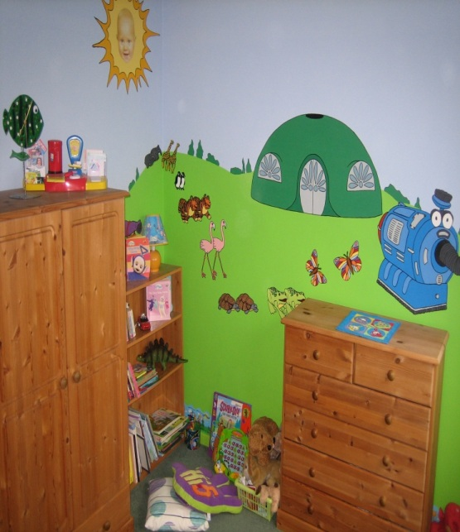
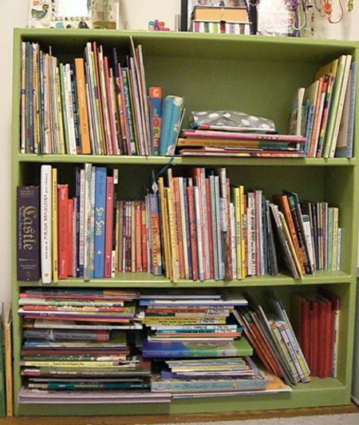
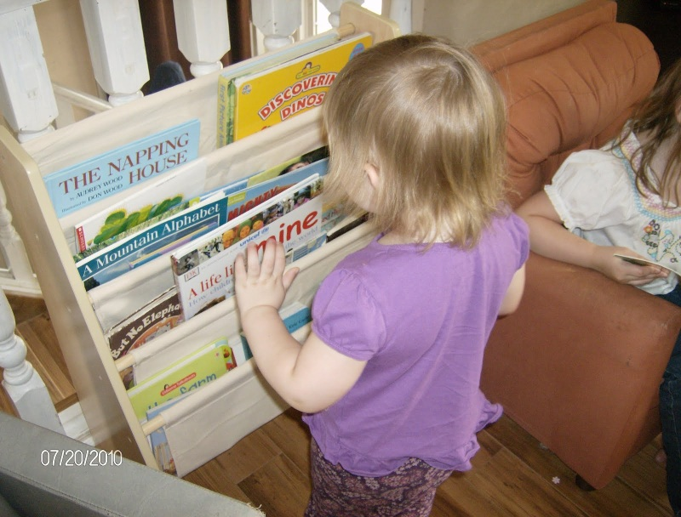
Keep a variety of reading materials in the house. Make sure to have books that are interesting to your child as well as for reference.
Have some books the children can read for themselves, some they need a little support with, and some for you to read.
Encourage them to have favourite books.

Slide 19
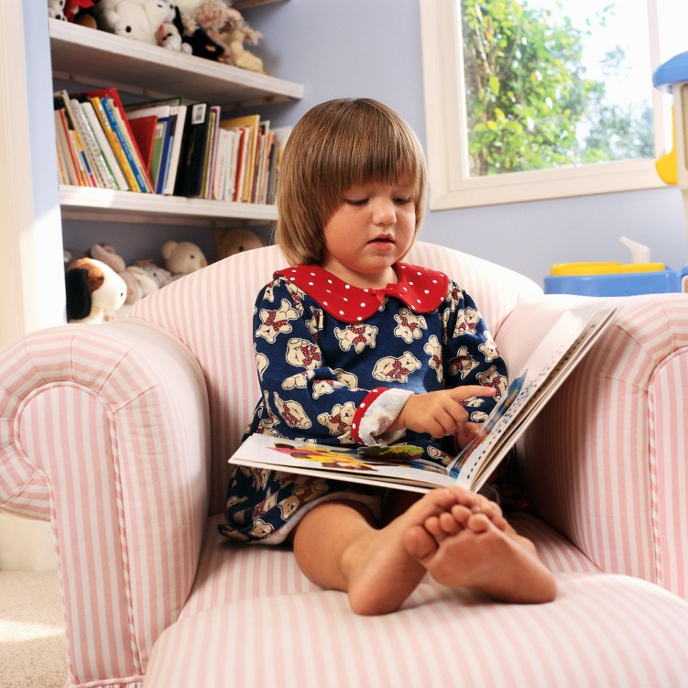
Encourage your child to read on their own at home. Reading at home can help your child do better in school.

Slide 20
Establish a reading time, even if it's only 10 minutes each day. Encourage your child to practice reading aloud and praise them as much as possible. Offer to read every other page. Have conversations and discussions about the book with your child.

Slide 21
Give your child writing materials. Reading and writing go hand in hand. Children want to learn to write and to practice writing. If you make pencils, crayons, and paper available at all times, your child will be more inclined to initiate writing activities on his own.

Slide 22
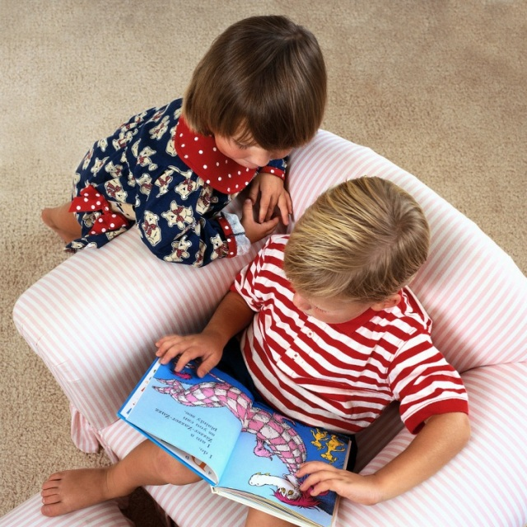
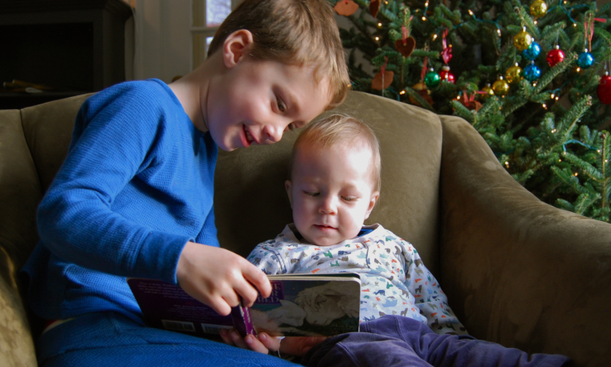
Visit the library on a regular basis. Have your child apply for her own library card so they can check out books on her own for schoolwork and for pleasure reading. Ask your child to bring home a library book to read to a younger sibling and encourage her to check out books on tape/cd that she can listen to on long car trips.

Slide 23
Pictures cues
Children look at pictures in books to help read unknown words.
‘The balloon is blue’.

Slide 24
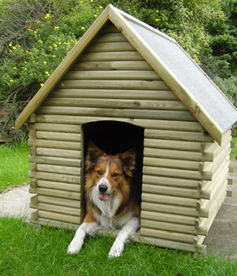
Life experiences
Children make sense of the text using their life experiences.
e.g knowing what a dog lives in will help decode the last word.
‘The dog is in the kennel’.

Slide 25
What to do with the reading book
Look at the front cover and ask your child what they think the book might be about and why? (prediction skills) Refer back to their ideas at the end to see if they were right.
Ask your child to point to the title. Can they sound the words out? Do they know any tricky words?

Slide 26
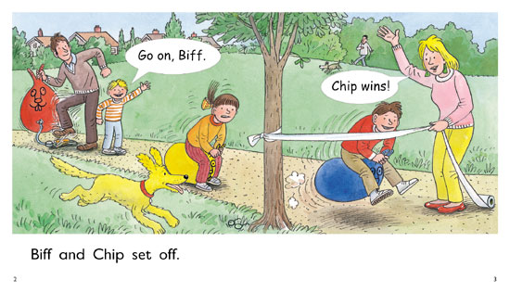
Encourage your child to look at the picture before reading the text so that they get an understanding of what is happening. Encourage them to sound out unfamiliar words using their phonic knowledge, unless they are ‘tricky words’, which need to be learnt by sight. Encourage your child to point to the words as they read them to ensure they are not relying on memory alone if having read the book before. Point out the speech bubbles and discuss what they are. How might the characters say their words? Encourage your child to adapt their voice, with you modelling this if necessary. Talk about the story setting. Where are they? How do they know?

Slide 27
READING TO YOUR CHILD
Once your child has read to you, or at another time, read to your child.
‘Reading to your child on a regular basis, especially at a young age, is just as crucial in helping them develop skills as a reader’.
Choosing the book.
Your child may have selected a library book from school or the local library.
Follow your child’s interests.
Consider the length of the book and the appropriateness.

Slide 28
Discuss the front cover – What do they think the book might be about ? Can they give reasons for their ideas?
( prediction/ reasoning skills)
What can they tell you about the picture? E.g It’s Winter time( snowing), there’s a hedgehog, hedgehogs don’t usually wear woolly hats. Does your child know that the hedgehog should be hibernating?

Slide 29
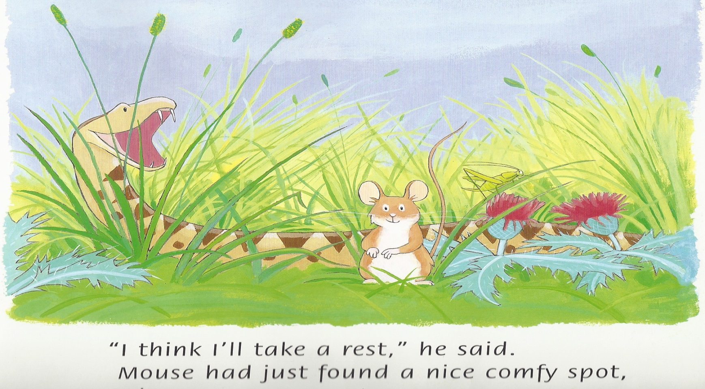
Stop at various points in a story and ask the child what might happen next (prediction skills).

Slide 30
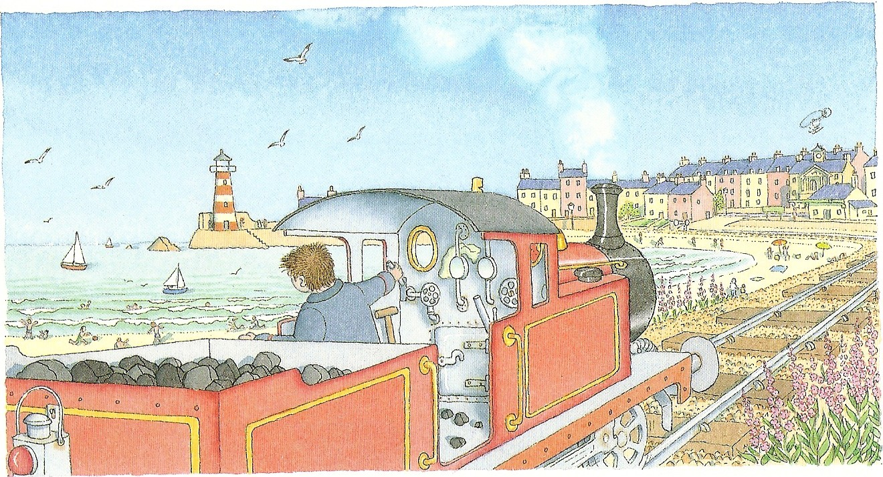
Can you see a /find a ….? ( skimming and scanning)

Slide 31
Read stories with repetitive sentences e.g
‘The Gingerbread Man’, ‘We’re going on a Bear Hunt’, and encourage your child to join in with the repetitive parts.

Slide 32
Read stories or poems that rhyme.
Can they hear the rhyming words?

Slide 33
Some stories are great to add sound effects too e.g ‘Peace at Last’. Get children to make sounds to accompany the story as you read it using vocal and/or body sounds.

Slide 34
Talk about the elements of a story – characters, setting, beginning, middle and end so that children become familiar with the structure of a story.

Slide 35
Read stories that introduce new vocabulary to helps develop children’s language. Ensure the children understand what the words mean.

Slide 36
Story vocab – Once upon a time….
Read a range of books, that interest your child. Fairy tales, Traditional tales, Cartoon characters. Stories about different seasons.

Slide 37
FACTUAL BOOKS
Does your child understand the difference between a ‘fiction’ and a ‘non-fiction’ (fact) text?
Do they know what kind of book it will be by looking at the front cover?

Slide 38
CONTENTS PAGE
Contents Pages are at the front of the book. They tell you the topics covered in page order.

Slide 39
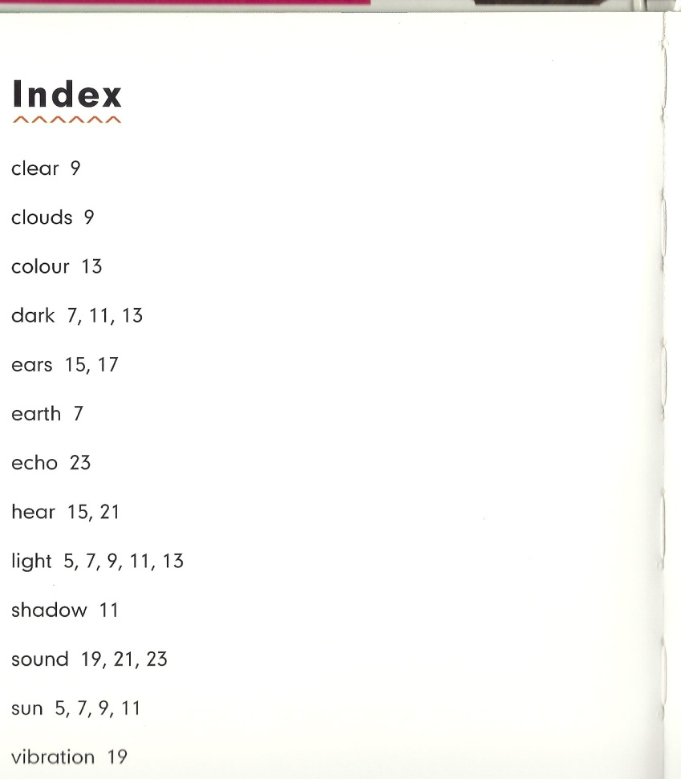
INDEX
Index pages, at the back of the book, have ‘key words’ in alphabetical order.

Slide 40
Ultimately….
Learning should be fun!
Learning should be life-long!
Learning can be anywhere, with anyone and at any time!
Your own awe and wonder for learning will rub off on your child and give them a hunger for learning, helping them have so much learning success.

